Slide 1
State Management

Slide 2
Agenda
HTTP is Stateless Protocol
Cookies
Sessions

Slide 3
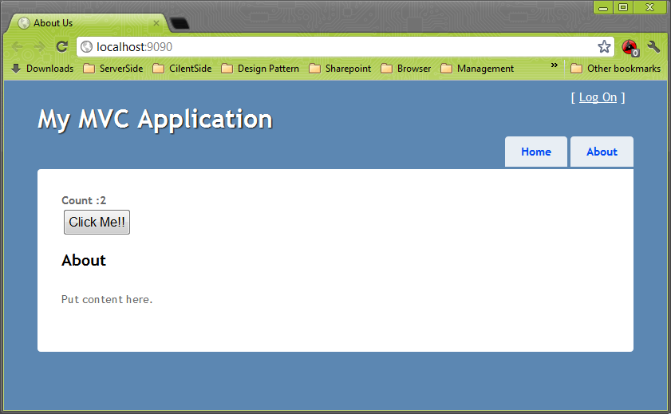
HTTP is Stateless Protocol
Lets See an Example

Slide 4
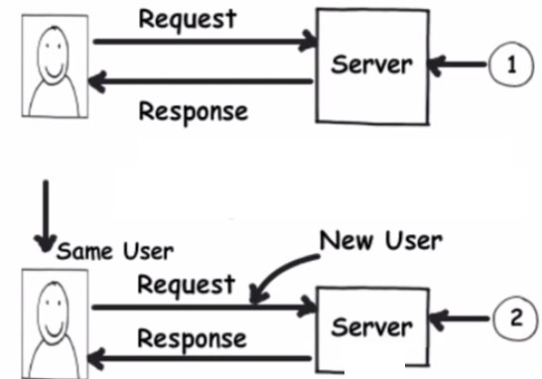
HTTP is Stateless Protocol

Slide 5
State Management
You choices for state management include:
Session
Cookies
ViewState
Application
Cache
QueryString

Slide 6
State Management
Session
Stored on the server.
Unique for each user.
Can expire.

Slide 7
State Management
Cookies
Stored at the client.
Can expire.

Slide 8
State Management
Application
Stored on the server and
shared for all users.
Does not expire.

Slide 9
State Management
ViewState
Stored in a hidden page input (by default).
Does not expire.

Slide 10
State Management
QueryString
Passed in the URL.
Must be maintained with each request.

Slide 11
Cookie
also known as an HTTP cookie, web cookie, or browser cookie
a small piece of data
sent from web server/Application and
stored in a user's web browser
while a user is browsing a website

Slide 12
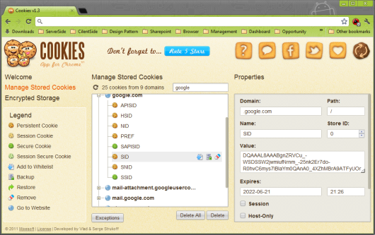
Cookie
Lets See How cookie look like?

Slide 13
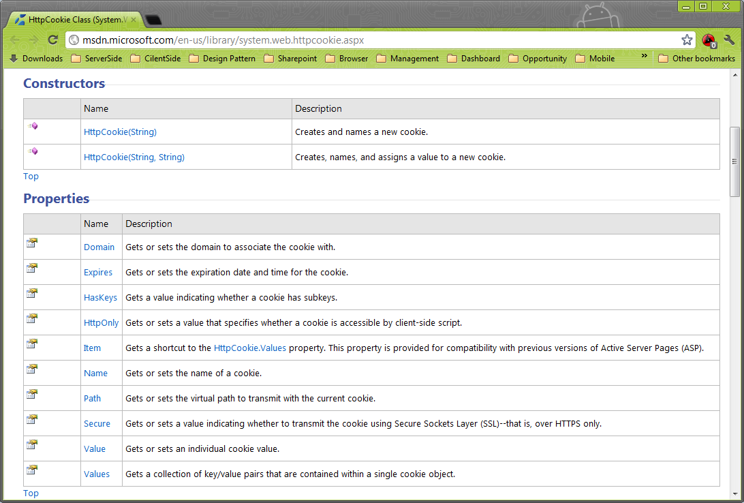
Cookie - HttpCookie Class

Slide 14
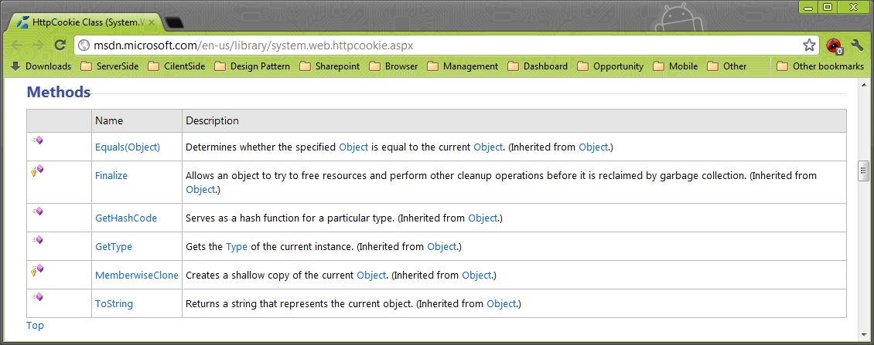
Cookie - HttpCookie Class

Slide 15
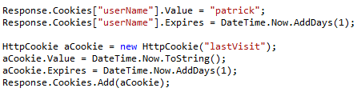
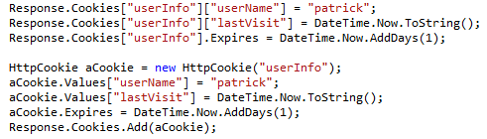
Cookie - Writing Cookies
Cookies with
One Value
Cookies with
More Than
One Value

Slide 16
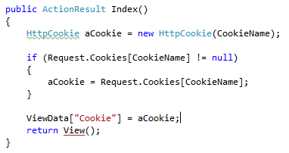
Cookie - Reading Cookies
Reading
Cookie

Slide 17
Cookie – Facts
If you do not set the cookie's expiration, the cookie is created but it is not stored on the user's hard disk. Instead, the cookie is maintained as part of the user's session information. When the user closes the browser, the cookie is discarded.
You cannot directly remove a cookie because the cookie is on the user's computer. The technique is to create a new cookie with the same name as the cookie to be deleted, but to set the cookie's expiration to a date earlier than today.

Slide 18
Session
Background on Session State in Asp.NET

Slide 19
Session
Session variables are stored in a SessionStateItemCollection object that is exposed through the HttpContext.Session property.
The current session variables are exposed through the Session property of the Page object.

Slide 20
Session
Session variable can be accessed through Integer Index or Name.
Session variables are created by referring to the session variable by name. You do not have to declare a session variable or explicitly add it to the collection
Setting &
Getting
Value

Slide 21
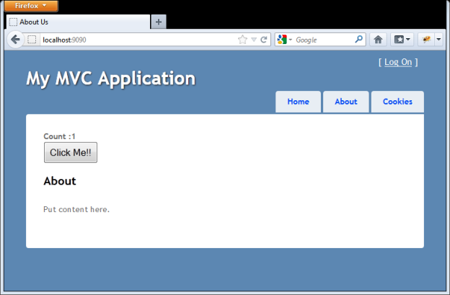
Session
Lets See Some Example

Slide 22
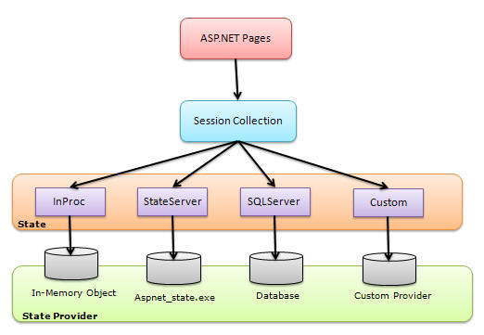
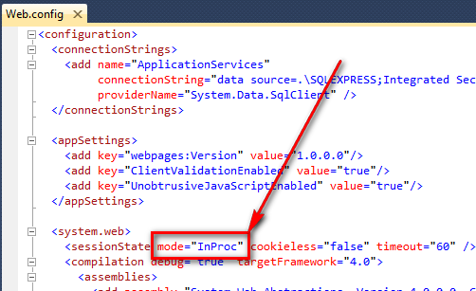
Session - Session Mode
there are the following session modes available:
Off
InProc
StateServer
SQLServer
Custom

Slide 23
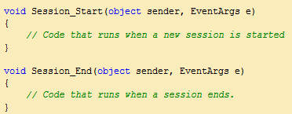
Session - Session Event
You can handle both these events in the global.asax file of your web application.
When a new session initiates, the session_start event is raised, and the Session_End event raised when a session is abandoned or expires.
Global.asax

Slide 24
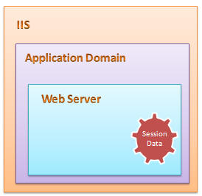

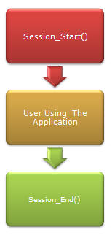
Session - InProc
This is the default session mode in ASP.NET
Its stores session information in the current Application Domain.

Slide 25

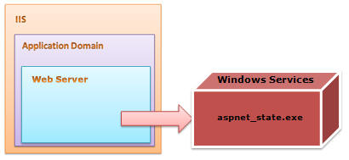
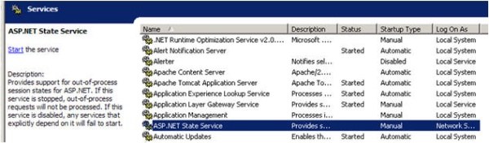
Sesion - StateServer Session Mode
This is also called Out-Proc session mode.
StateServer uses a stand-alone Windows Service which is independent of IIS and can also be run on a separate server

Slide 26
Thank You

